Slide 1
Shortcuts
For Visual Studio & Visual Assist

Slide 2
Editing

Slide 3
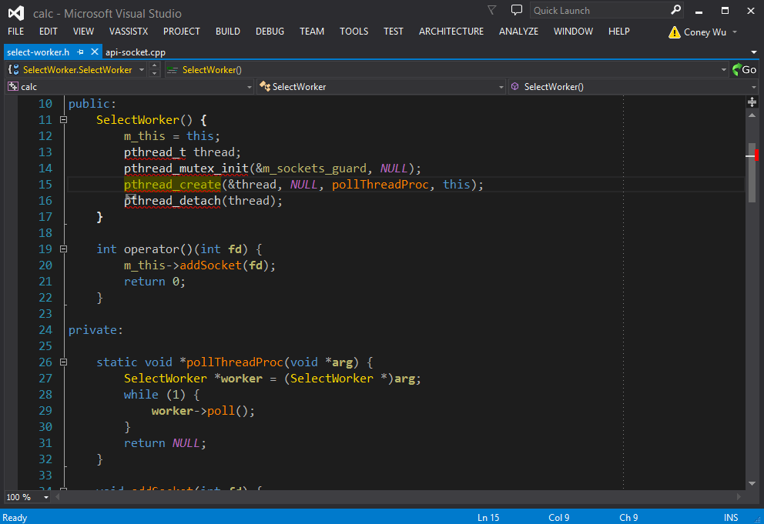
Jump Words
Ctrl + ←/→

Slide 4
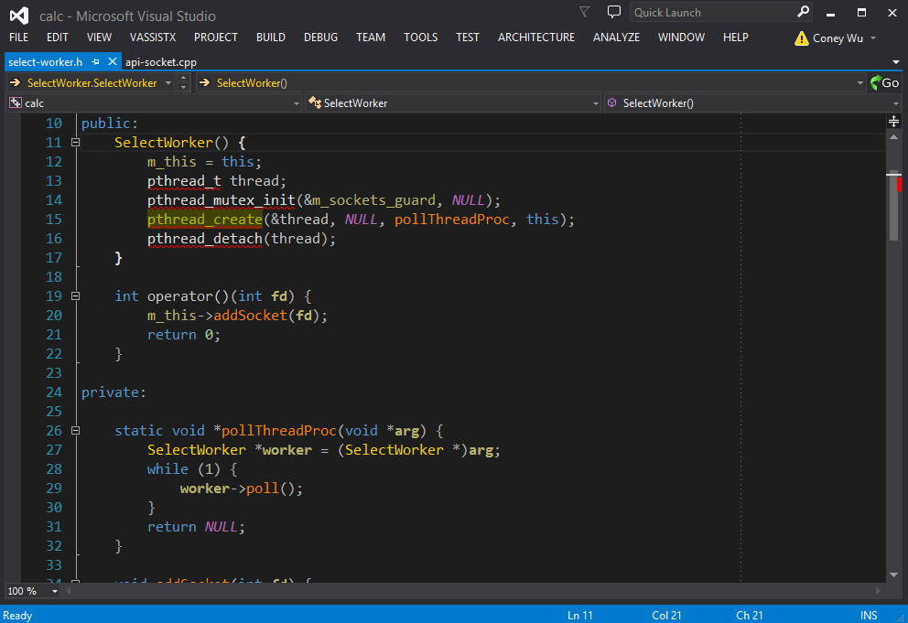
Jump Between Brackets
Ctrl + ]

Slide 5

Select Words
Ctrl + Shift + ←/→

Slide 6
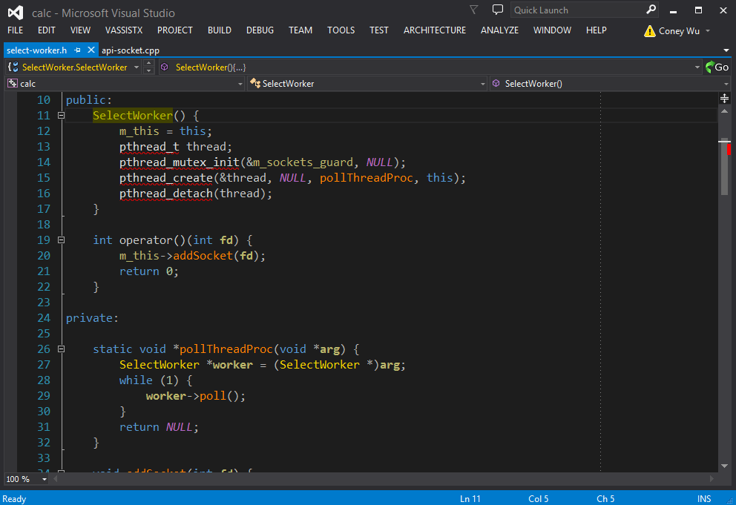
Select Lines
Shift + ↑/↓

Slide 7
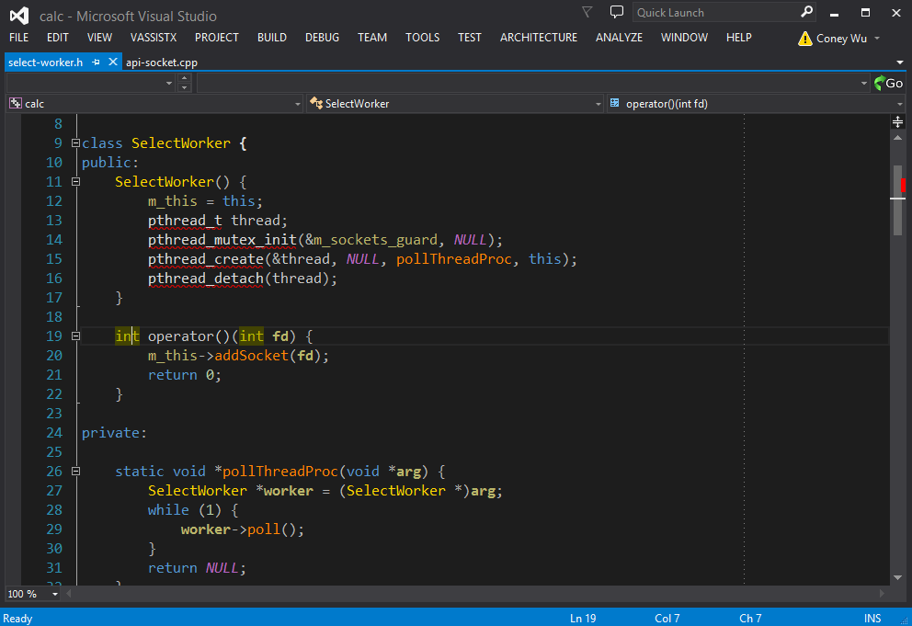
Delete Lines
Ctrl + Shift + L / Ctrl + X

Slide 8
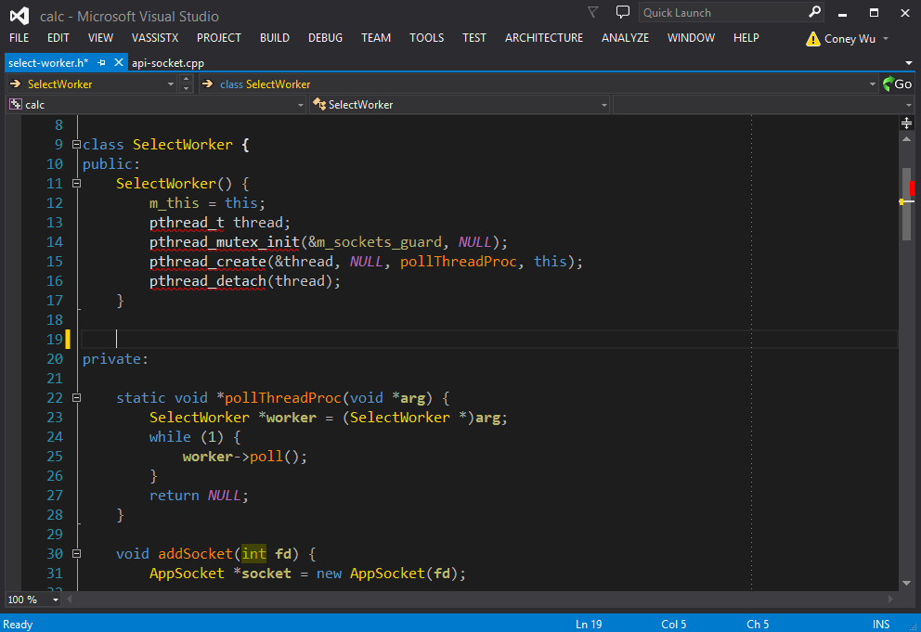
Cycle Clipboard
Ctrl + Shift + V

Slide 9
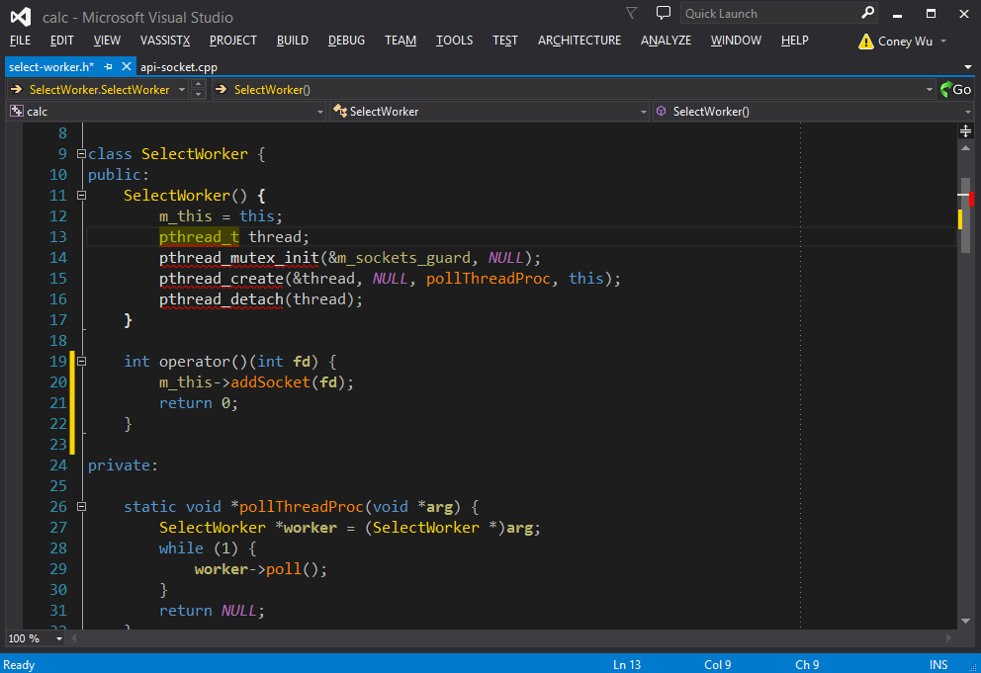
Multiline Editing
Alt + Shift + ↑/↓/←/→

Slide 10
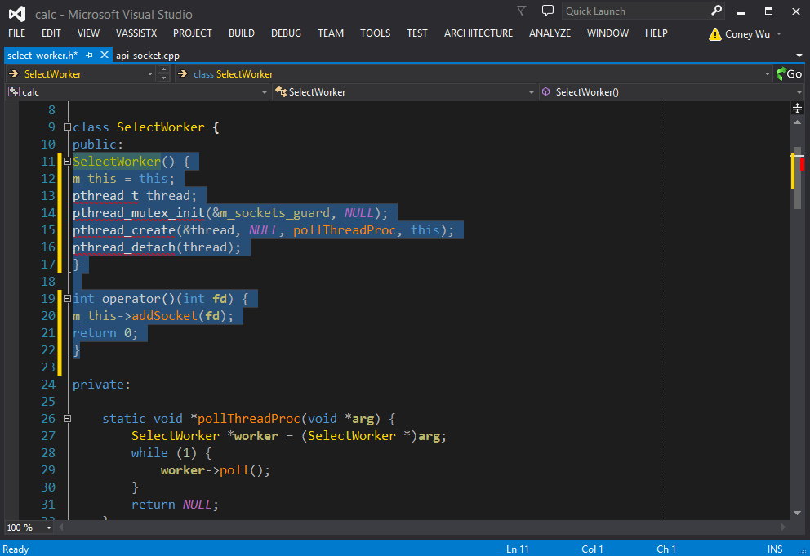
Format Code
Ctrl + K, F(Press K then F)

Slide 11
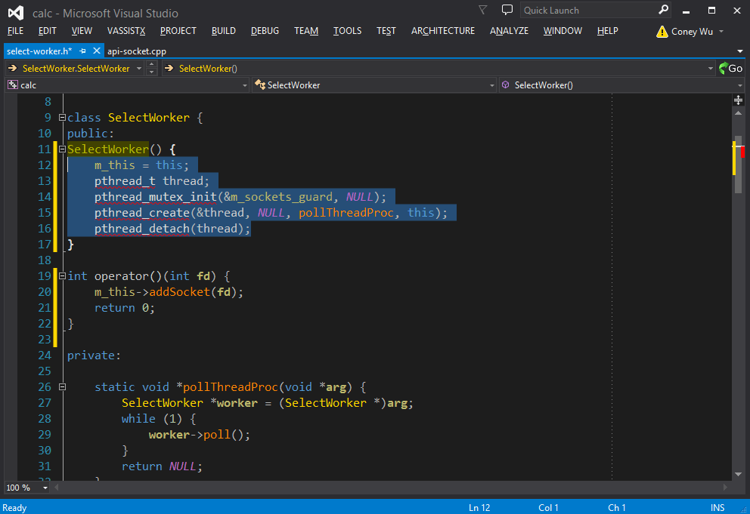
Comment Code
Ctrl + K, C

Slide 12
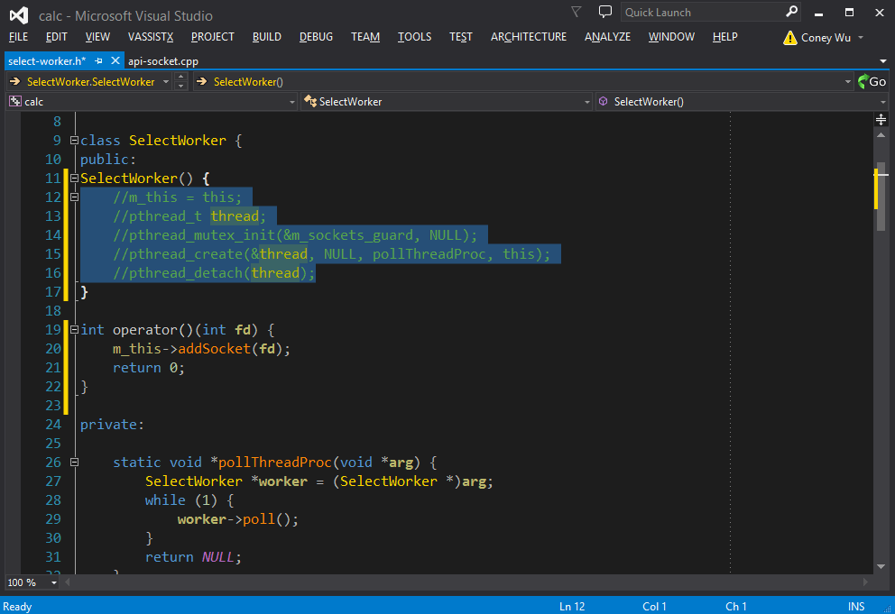
Uncomment Code
Ctrl + K, U

Slide 13
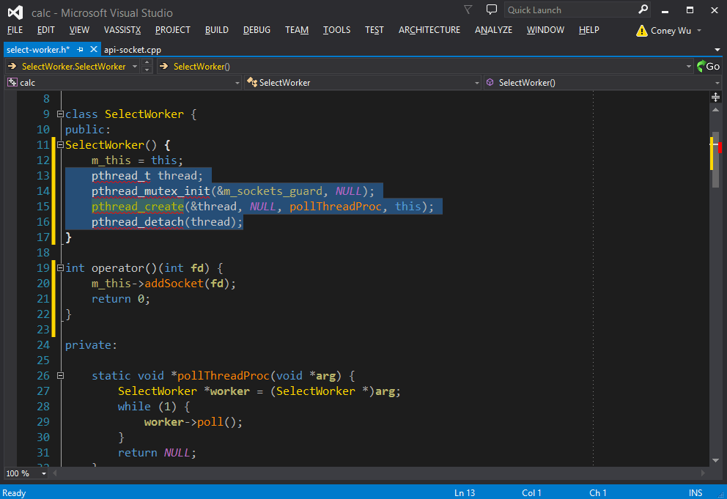
Surrond Select With
Ctrl + K, S

Slide 14
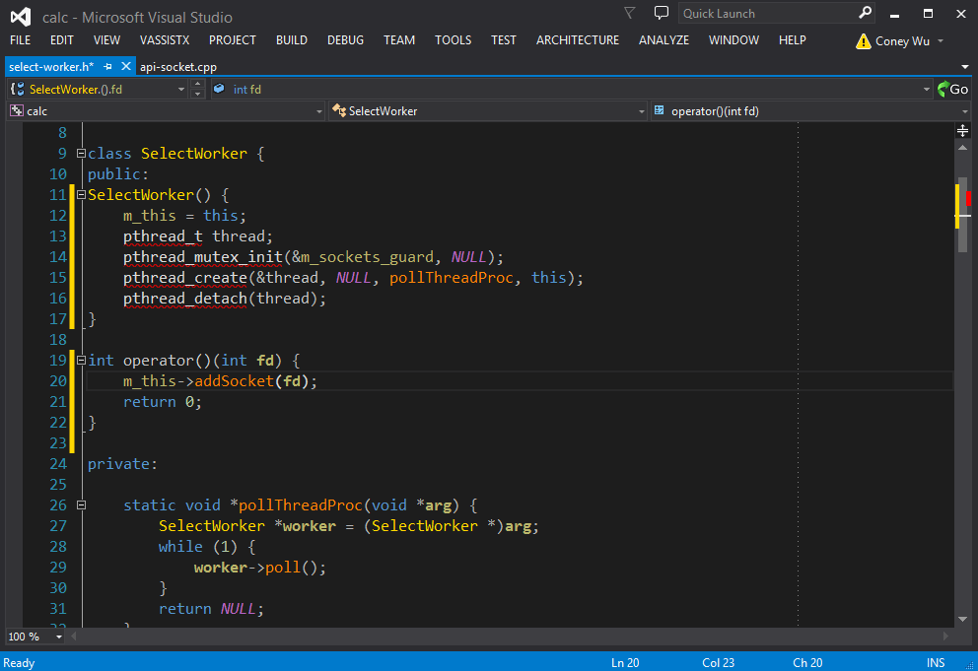
Show Tooltips
Ctrl + Shift + Space

Slide 15
Navigation

Slide 16
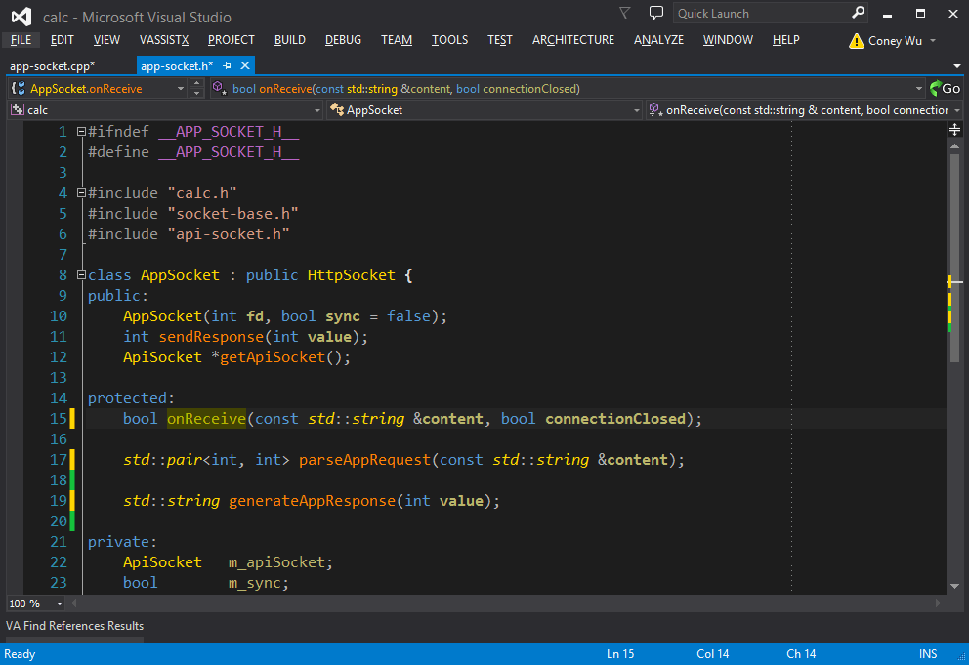
Goto Implementation
Alt + G

Slide 17
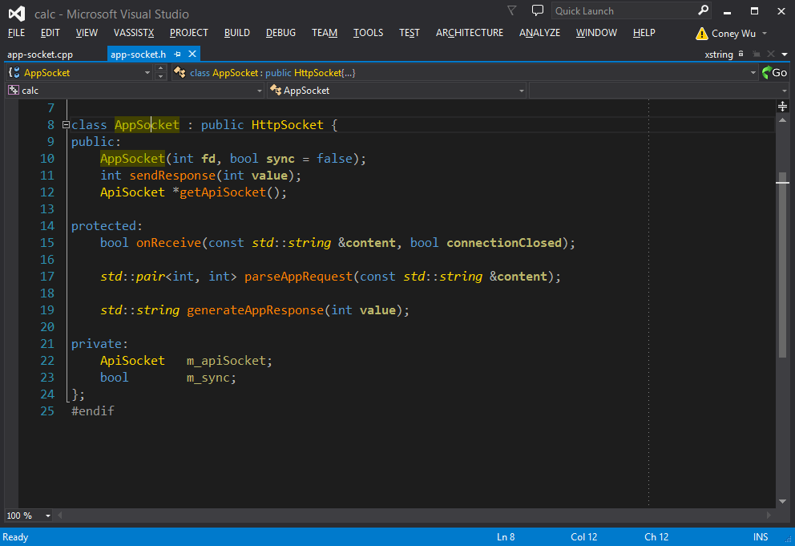
Goto Related
Alt + Shift + G

Slide 18
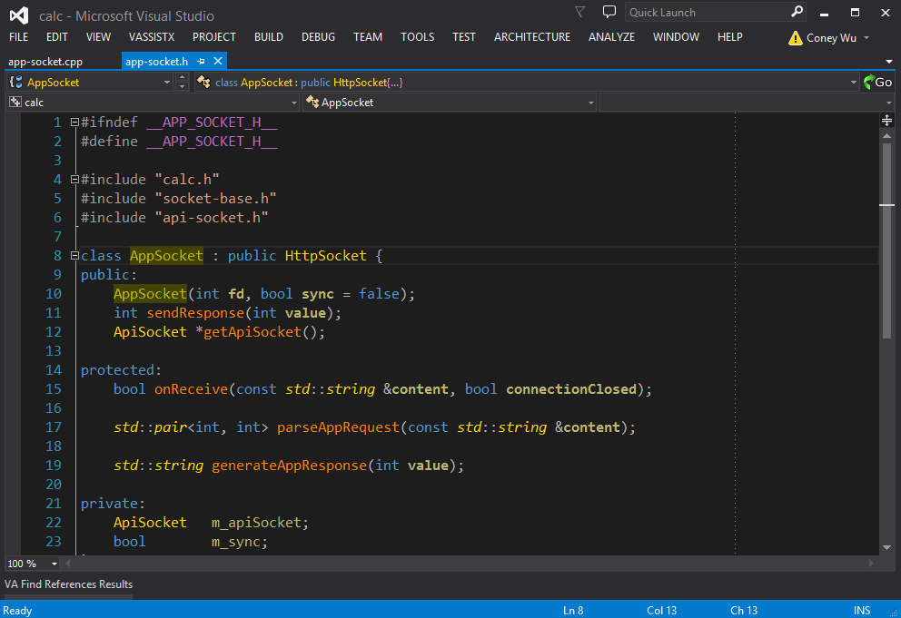
Find References
Alt + Shift + F

Slide 19
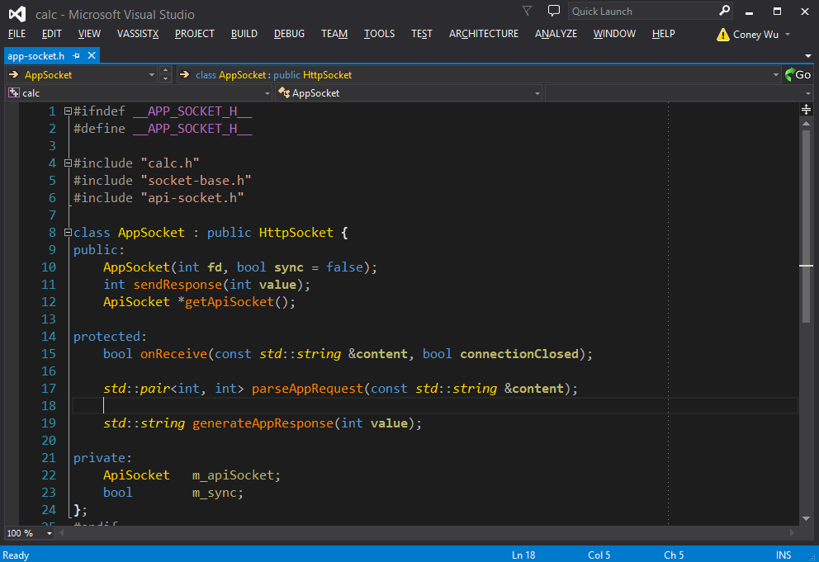
Switch Header / Source
Alt + O

Slide 20
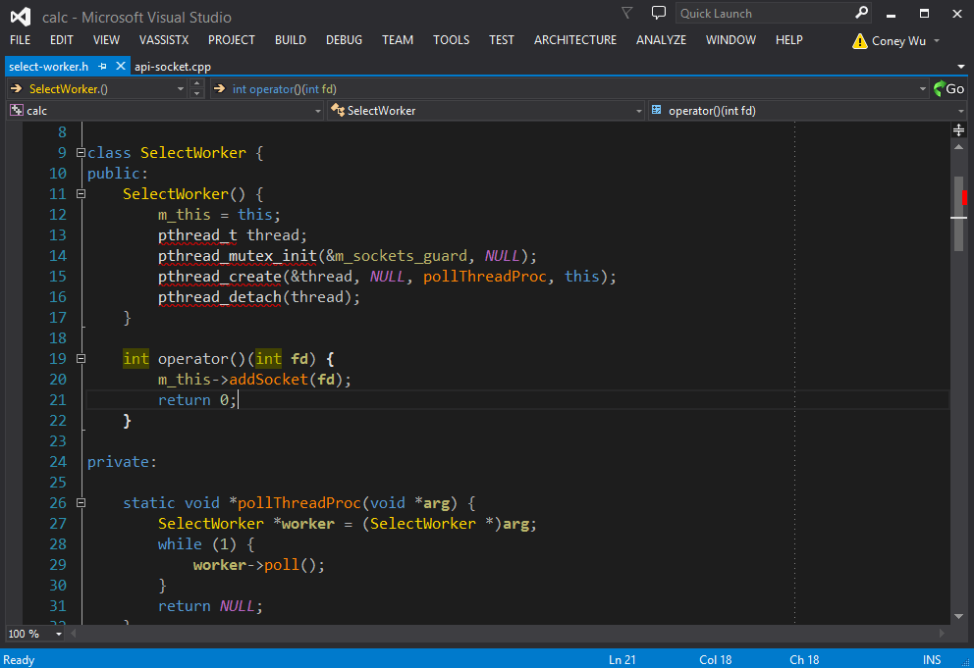
Open File
Alt + Shift + O

Slide 21
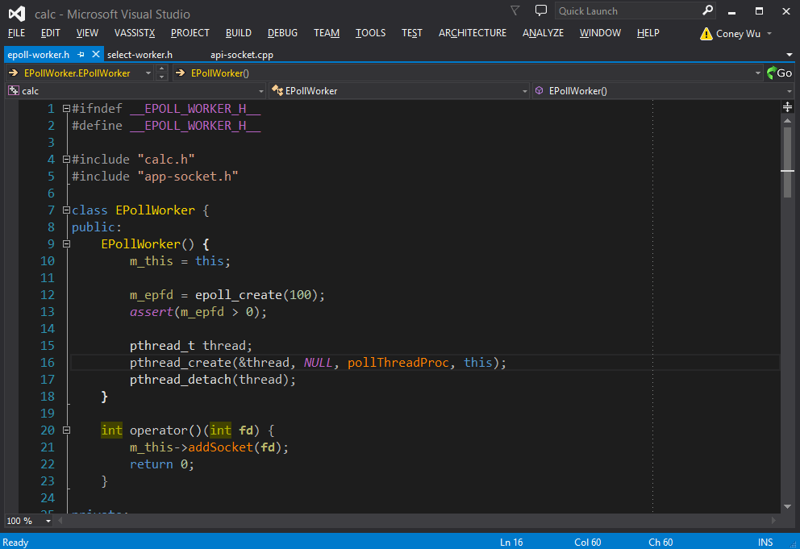
Open Symbol
Alt + Shift + S

Slide 22
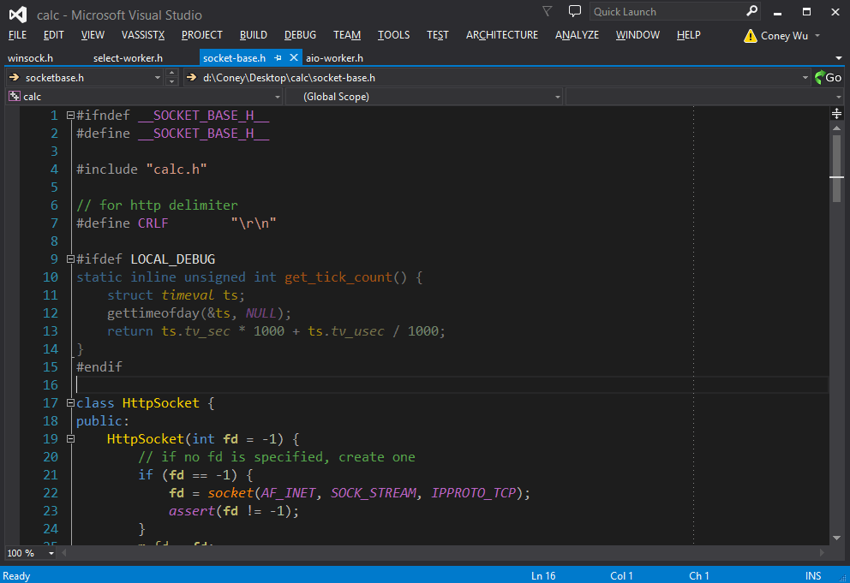
List Methods In Current File
Alt + M

Slide 23
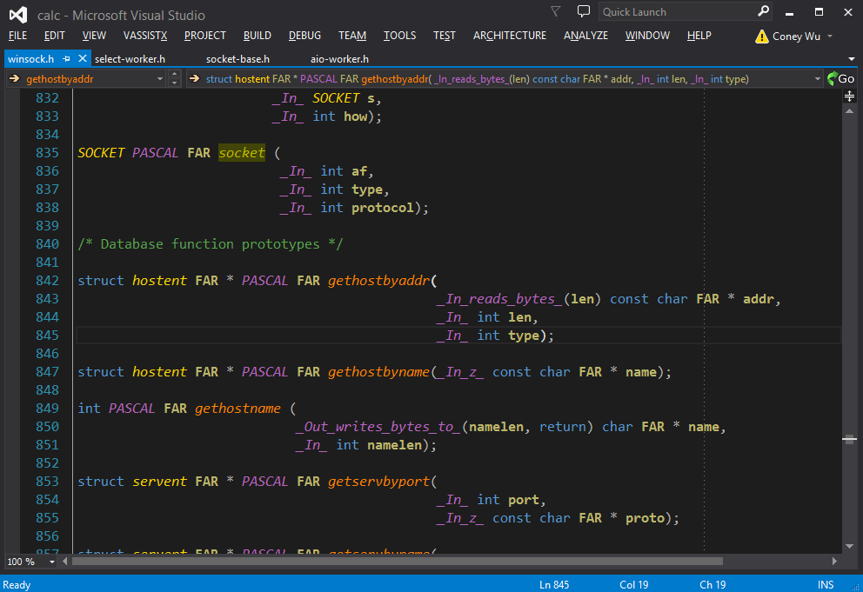
Navigate Back/Forward
Alt + ←/→

Slide 24
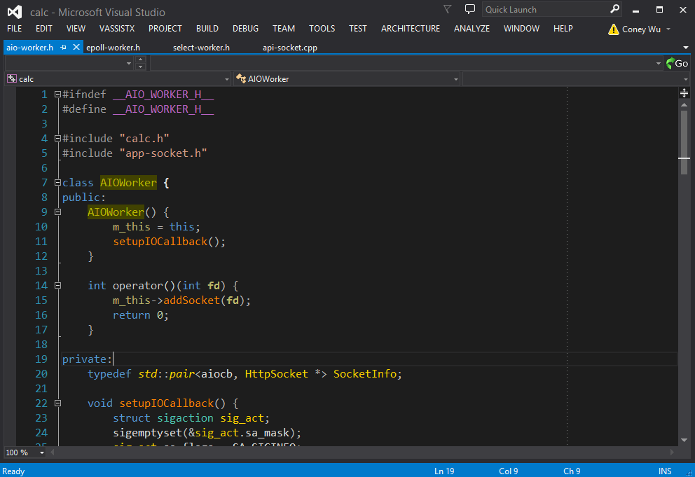
Switch Between Opened Tabs
Ctrl + Tab

Slide 25
Refactoring

Slide 26
All In One Shortcut
Alt + Shift + Q

Slide 27
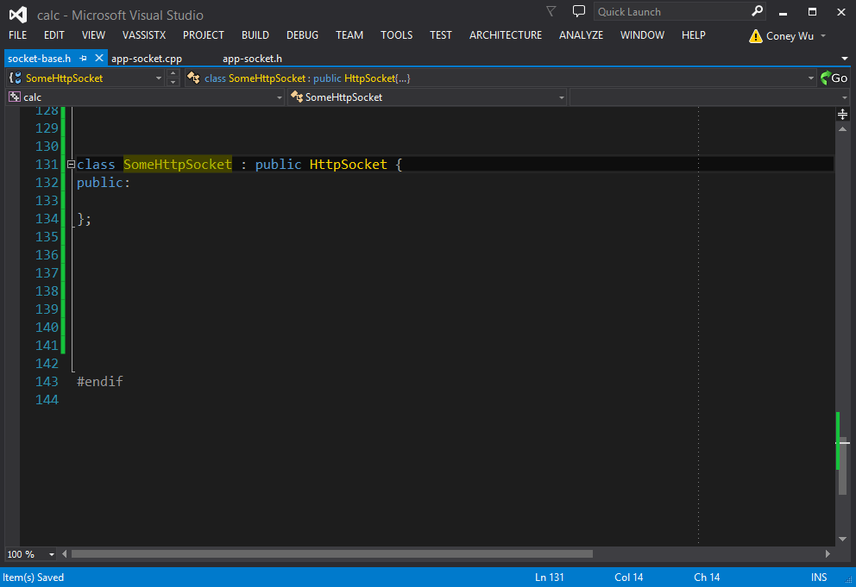
Implements Virtual Functions
On Derived Class

Slide 28
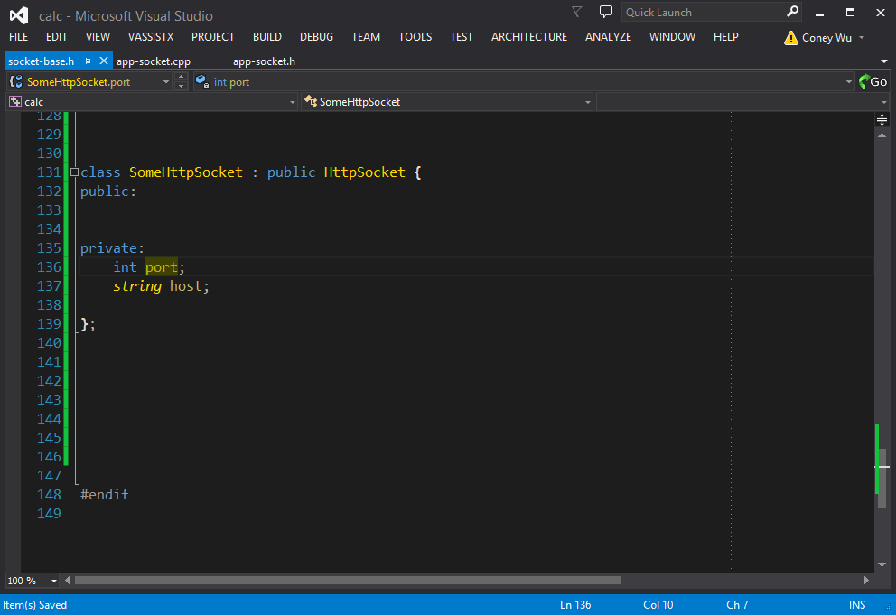
Encapsulate Fields(getter/setter)
On Member Variable

Slide 29
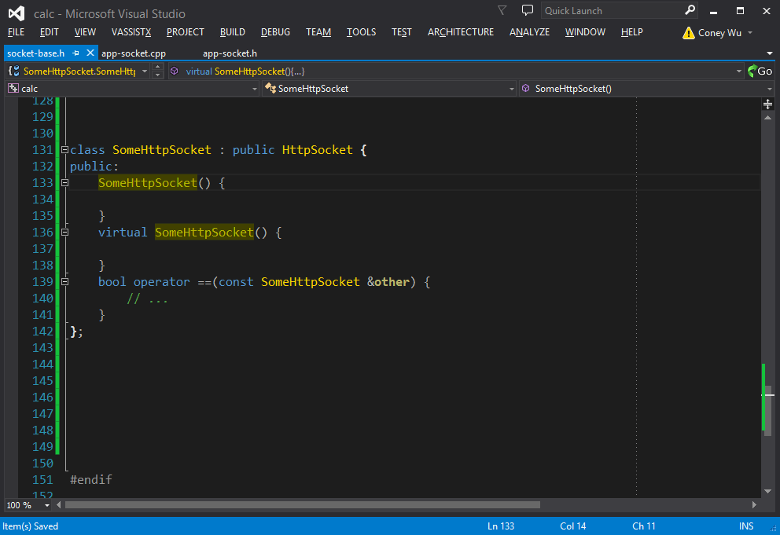
Rename
On Everything(Shift + Alt + R)

Slide 30
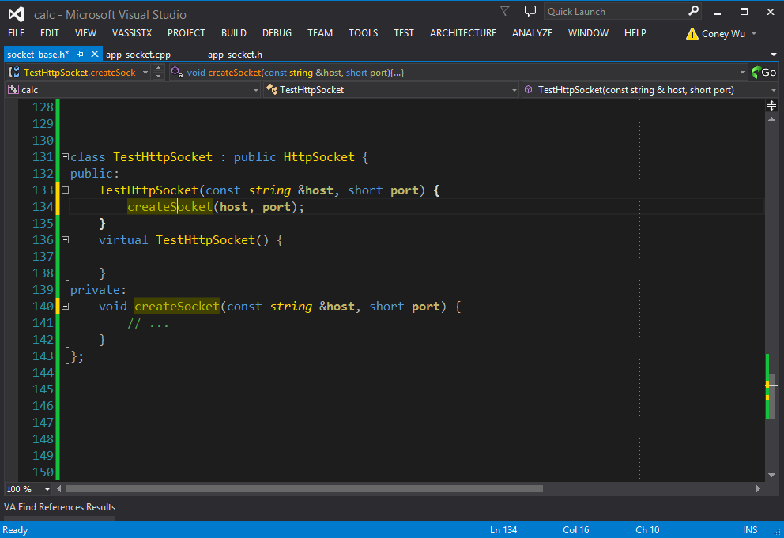
Change Signature
On Function

Slide 31
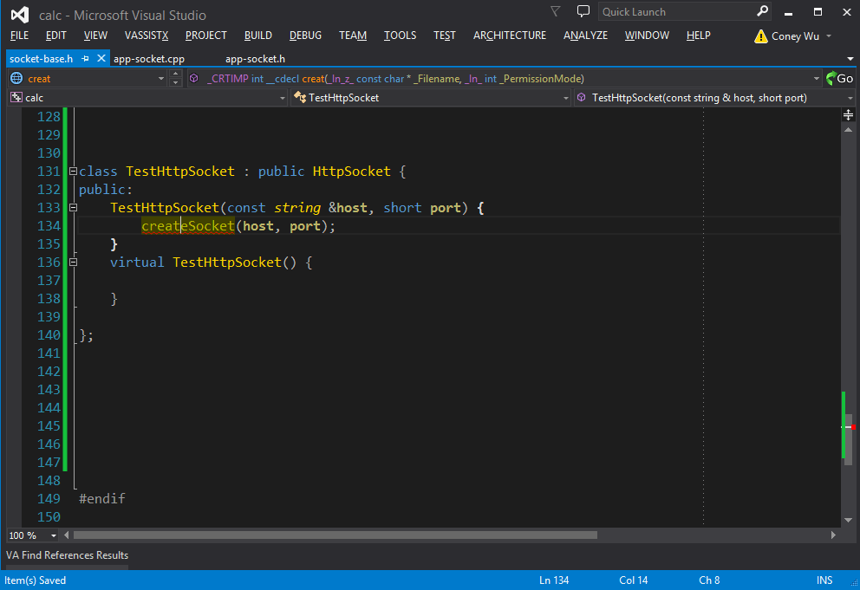
Create From Usage
On Function Call(Alt + Shift + C)

Slide 32
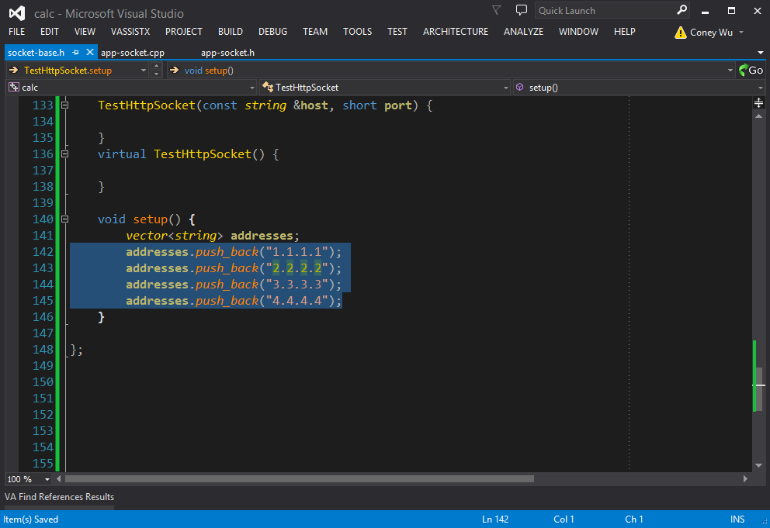
Extract Method/Variable
On Selected Code Block

Slide 33
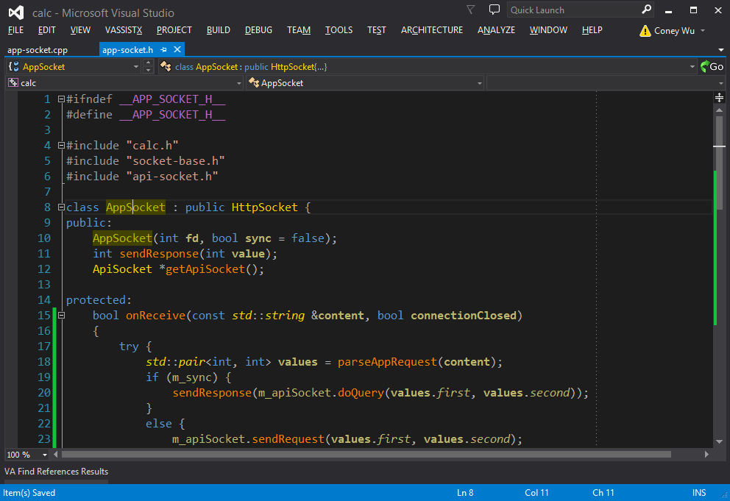
Move Implementation
On Class/Member Function

Slide 34
More References
Visual Studio Shortcuts
https://msdn.microsoft.com/en-us/library/da5kh0wa.aspx
Visual Assist Shortcuts
http://docs.wholetomato.com/default.asp?W375
IntelliCommand
https://visualstudiogallery.msdn.microsoft.com/83f59659-abc1-4bfa-9779-42f687af0481

Slide 35
THANK YOU
For questions or suggestions:
Wu Kun
kunwu@thoughtworks.com

